Slide 1
Role-based Access Control with CJOC

Slide 2
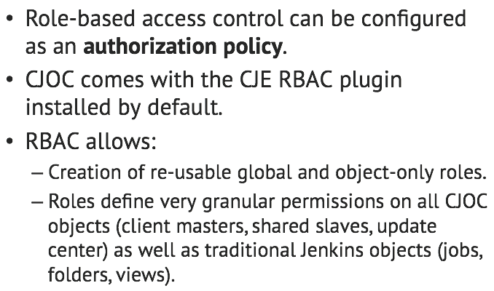
How do I use CJE RBAC with CJOC?

Slide 3
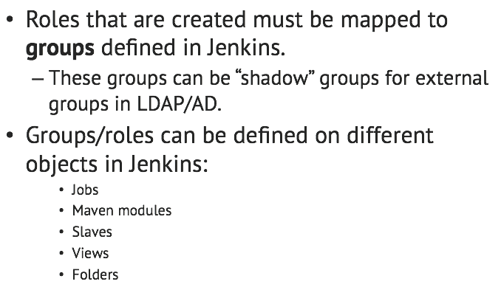
How do I use CJE RBAC with CJOC?

Slide 4
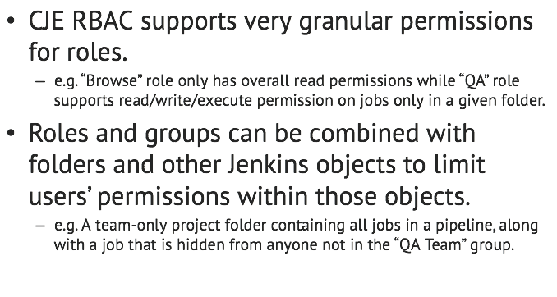
Benefits: granularity

Slide 5
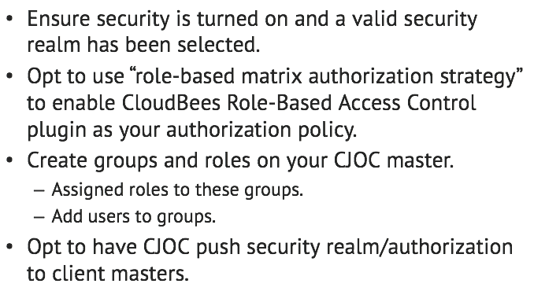
Where do we start?

Slide 6
Lab Exercise:
Setting up Role-based Access Control

